Slide 1
Principles of Data Science
Li Niu

Slide 2
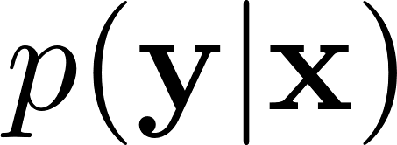
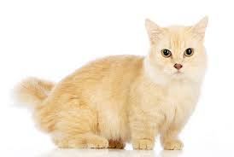
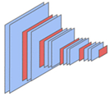
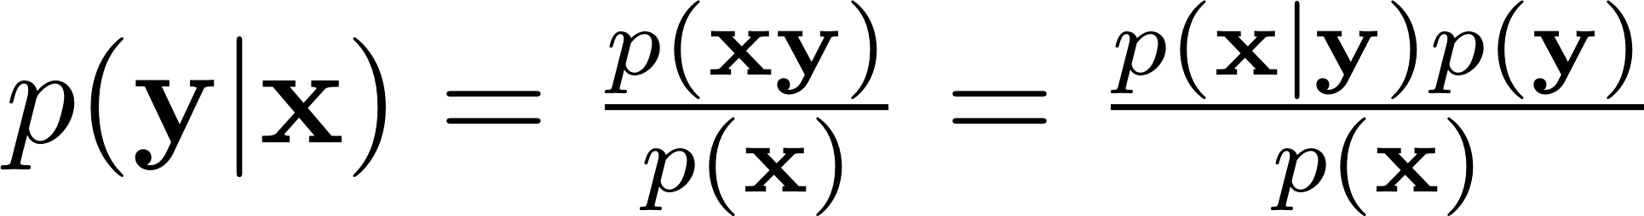
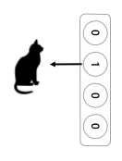
Discriminative and generative model
Discriminative model:
cat
dog
bird
….
Generative model:

Slide 3
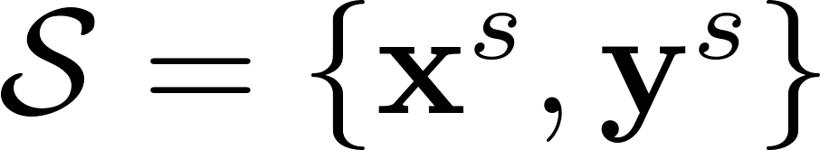
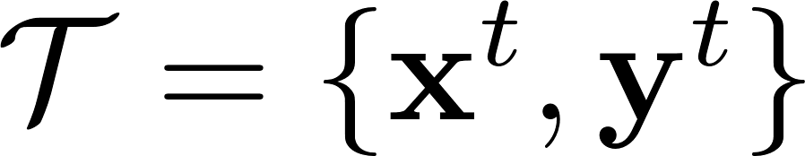
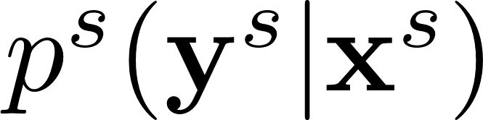
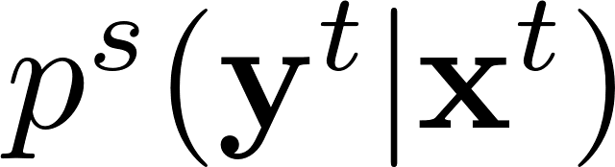
Source domain and target domain
Training on training set (source domain):
Testing on test set (target domain):

Slide 4
Classification
Learn a classifier to separate positive samples from negative samples.
positive
negative
Set A

Slide 5

Bias
positive
negative
Set A

Slide 6
No bias
positive
negative
Set A

Slide 7
Variance
positive
negative
Set A
Set B

Slide 8
How to strike the balance between bias and variance?
positive
negative
Set A

Slide 9
How to strike the balance between bias and variance?
positive
negative
Set A
Set B

Slide 10
Another suite of terminologies ….

Slide 11
Underfitting
positive
negative
Training set

Slide 12
Overfitting
positive
negative
Training set
Testing set

Slide 13
Overfitting and underfitting
positive
negative
appropriate
underfitting
overfitting
classifier

Slide 14
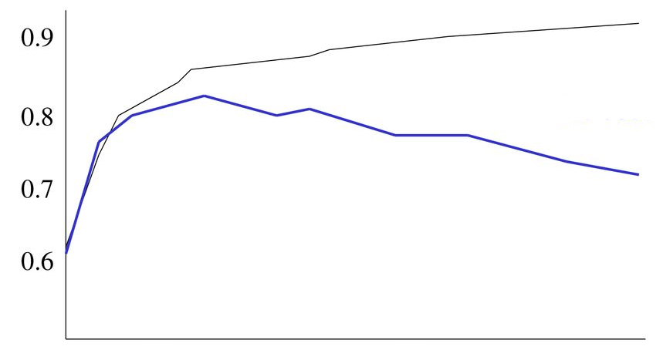
Overfitting and underfitting
Accuracy
training set
test set
underfitting
overfitting
Training epoch
Underfitting: training accuracy test accuracy
Overfitting: training accuracy test accuracy

Slide 15
Overfitting and underfitting
Accuracy
training set
test set
underfitting
overfitting
Training epoch
turning point
The turning point depends on the data distribution difference between training set and test set.

Slide 16

Overfitting and underfitting
0.8
0.7
0.6
0.5
0.4
0.3
0.2
Accuracy
training/test set
Training epoch
Extreme case: training set and testing set are exactly the same

Slide 17
Overfitting and underfitting
0.8
0.7
0.6
0.5
0.4
0.3
0.2
Accuracy
training set
test set
Training epoch
Extreme case: the labels of training set and testing set are opposite

Slide 18
How to address underfitting?
Increase model parameters
Reduce training set

Slide 19
How to address overfitting?
Reduce model parameters
Enlarge training set

Slide 20
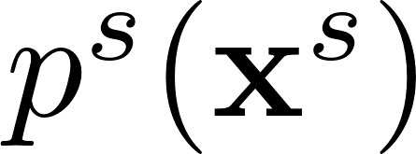
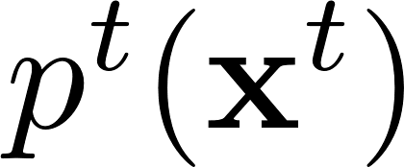
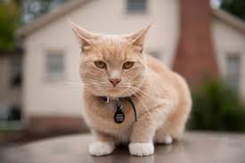
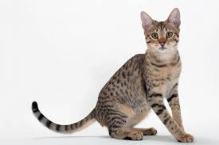
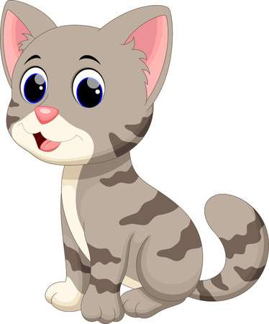

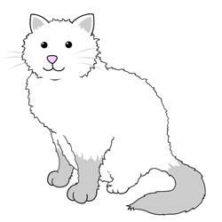
Data distribution mismatch
v.s.

Slide 21
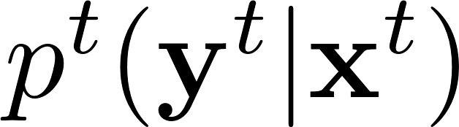
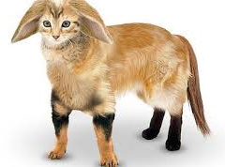
Data distribution mismatch
v.s.
cat
cat
dog
dog
bird
bird
….
….

Slide 22
Data distribution mismatch
When the data distributions of training set and testing set are similar
Training set
Testing set

Slide 23
Data distribution mismatch
When the data distributions of training set and testing set are slightly different
Training set
Testing set

Slide 24
Data distribution mismatch
When the data distributions of training set and testing set are totally different
Training set
Testing set

Slide 25
Domain adaptation
Training set
Testing set
adapt classifier
to test set

Slide 26
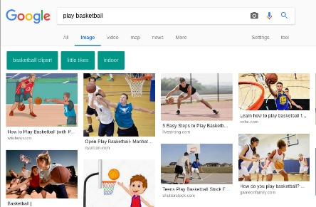
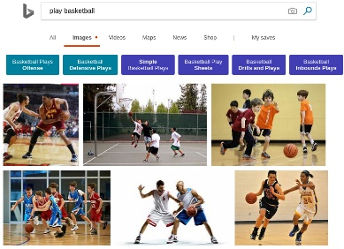
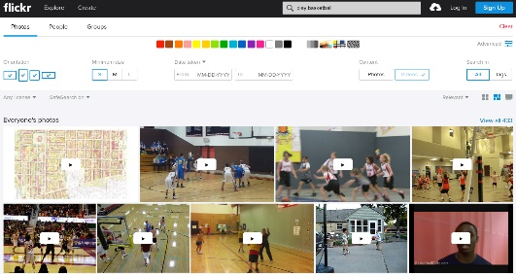
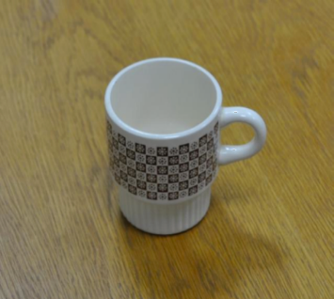
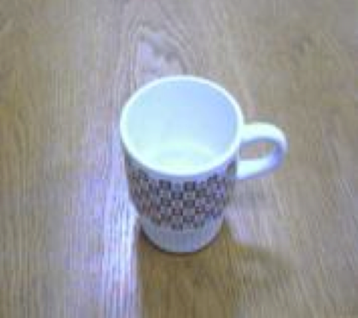
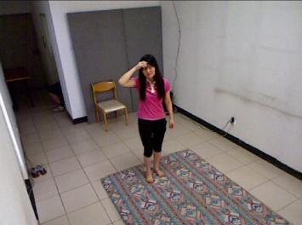
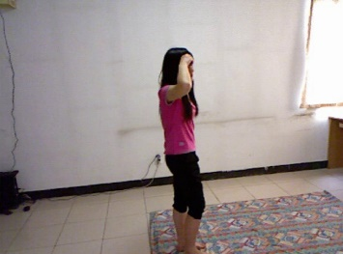
Different homogeneous domains
Different data sources
Google
Bing
Flickr
Different capture devices
Different camera viewpoints
DSLR camera
low-cost camera
front view
side view

Slide 27
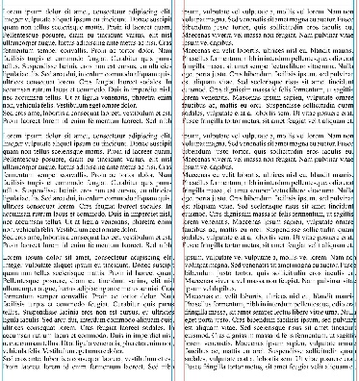
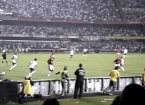
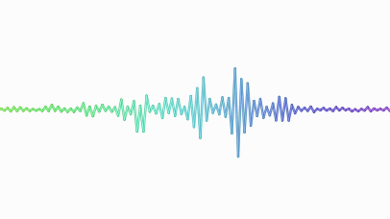
Different heterogeneous domains
Cross-modality
vision
text
sound

Slide 28
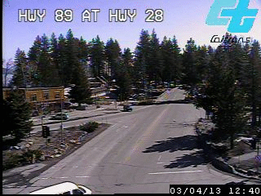
Examples
Application of domain adaptation
Autonomous driving
The driving environment changes in a continually evolving way.
Innumerable driving environments: peak/off-peak, daytime/night, etc
Notes:
First, I’d like to explore some specific applications for domain adaptation. The domain shift is a widely existing problem in many real-world applications.
One important application of transfer learning is medical image analysis, for example, cancer classification based on CT images. The CT images of different patients are quite different in data distribution. The CT images captured by different machines are also quite different in data distribution. So there are many research opportunities for transfer learning in medical image analysis.

Slide 29
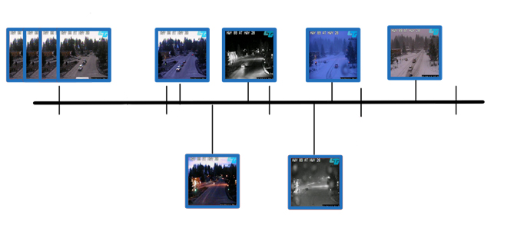
Examples
Application of domain adaptation
Autonomous driving
driving environment A
(Day 1)
adapt
driving environment B
(Day 2)
Day 1
9:00
Day 1
15:00
Day 1
21:00
Day 2
3:00
Day 2
9:00
Notes:
First, I’d like to explore some specific applications for domain adaptation. The domain shift is a widely existing problem in many real-world applications.
One important application of transfer learning is medical image analysis, for example, cancer classification based on CT images. The CT images of different patients are quite different in data distribution. The CT images captured by different machines are also quite different in data distribution. So there are many research opportunities for transfer learning in medical image analysis.

Slide 30
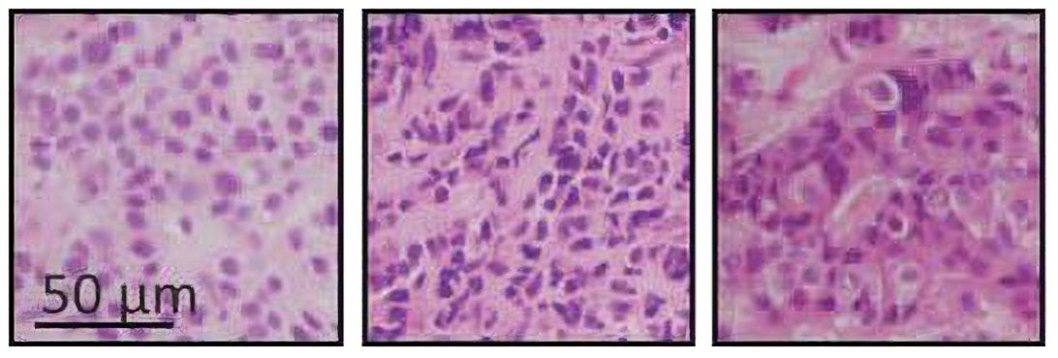
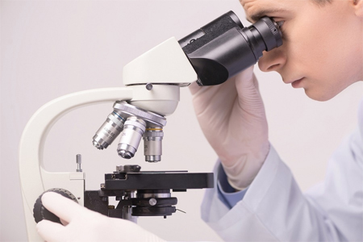
Examples
Application of domain adaptation
Medical diagnosis
adapt
patient A patient B
patient 1
patient 2
patient 3
liver tumor
Notes:
First, I’d like to explore some specific applications for domain adaptation. The domain shift is a widely existing problem in many real-world applications.
One important application of transfer learning is medical image analysis, for example, cancer classification based on CT images. The CT images of different patients are quite different in data distribution. The CT images captured by different machines are also quite different in data distribution. So there are many research opportunities for transfer learning in medical image analysis.

Slide 31
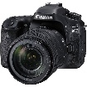
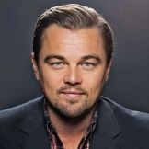
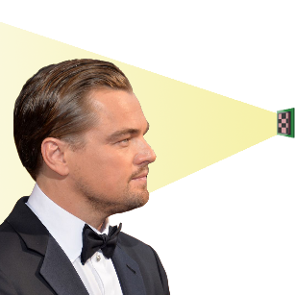
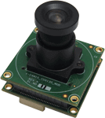
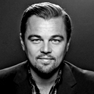
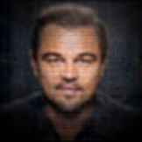
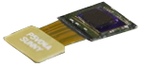
Examples
Application of domain adaptation
Video surveillance
adapt
camera A camera B
RGB camera
model
Leonardo
NIR camera
…
…
lensless camera
Notes:
Another important application of transfer learning is to transfer between different camera modalities. Currently, most images and videos are captured by RGB camera. However, besides RGB camera, there are many other camera modalities, which are applicable in different scenarios, like NIR camera and lensless camera. NIR camera is used at night to capture what we human cannot see in the darknets. lensless camera is very thin and cheap, and can be used for Internet of thing. We need to transfer between different camera modalities to get the target information we want. We usually refer to deep learning system as an end-to-end system. But I think the real end-to-end system should be from the real world to the target information, instead of from RGB images to the target information.

Slide 32
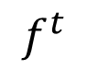
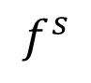
Domain adaptation
positive samples
negative samples
source
target

Slide 33
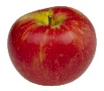
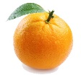

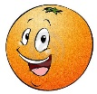


Domain generalization
Domain adaptation: unlabeled target domain is seen in the training stage.
mismatch
source domain
target domain
Domain generalization: unlabeled target domain is unseen in the training stage.
mismatch
?
source domain
target domain

Slide 34
Domain generalization
Domain adaptation: unlabeled target domain is seen in the training stage.
mismatch
source domain
target domain
Domain generalization: unlabeled target domain is unseen in the training stage.
mismatch
…
A or B or C
domain A
domain B
multiple latent domains
target domain

Slide 35
Thanks!

